Slide 1
Group1
Biopure Corporation

Slide 2
Background
•Biopure Corporation founded in 1984 by Carl Raush & David Judelson
•Products (blood substitutes): Oxyglobin & Hemopure
•Invested $200 M in development
•Currently no revenues with very little debt & financing of $50 M to support operations for another 2 yrs
•Stakeholders anxious to make the company public

Slide 3
Problem Statement
When to launch Oxyglobin ?
Postpone the launch of Oxyglobin until and after Hemopure Had established itself in the marketplace
OR
Immediately launch Oxyglobin and reap the near term benefits ?

Slide 4
Company | Biopure Corporation | Northfield Laboratories | Baxter International
Product | Oxyglobin & Hemopure | PolyHeme | HemAssist
Source of Hemoglobin | Bovine Blood | Outdated RCB of Human Blood | Outdated RCB of Human Blood
Cost of Production | $15 M | $70 M | $50 M
Raw Material Cost | $1.5 per unit | $26 per unit | $8 per unit
Storage | Stable at room temp. | Need to be frozen < 4°C | Need to be frozen < 4°C
Clinical Trial Phase | Oxyglobin - All cleared Hemopure - Phase 3 (1998) | Phase 3 (1998) | Phase 3 (1998)
Pricing | Oxyglobin - $80-$200 Hemopure - $600-$800 | $600-$800 | $600-$800

Slide 5
Reasons against immediately launching Oxyglobin
A chance to establish better in IPO
Allow the department to gather all the resources and building up on the supply chain
Market might not accept a higher price point for Hemopure
A perception that Biopure is a pure veterinary brand

Slide 6
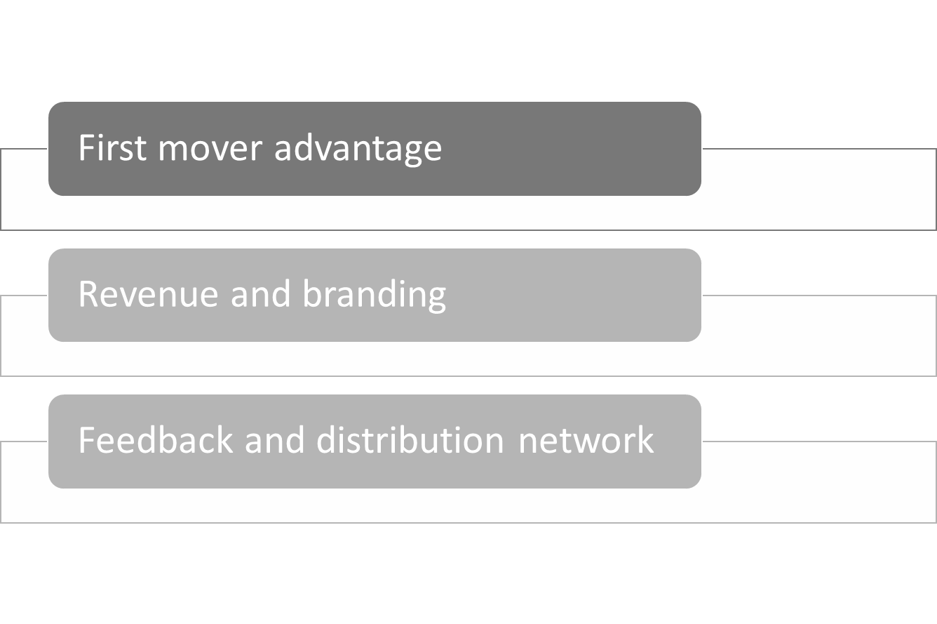
Reasons for immediately launching Oxyglobin

Slide 7
MARKET POTENTIAL OF HEMOPURE AND OXYGLOBIN

Slide 8
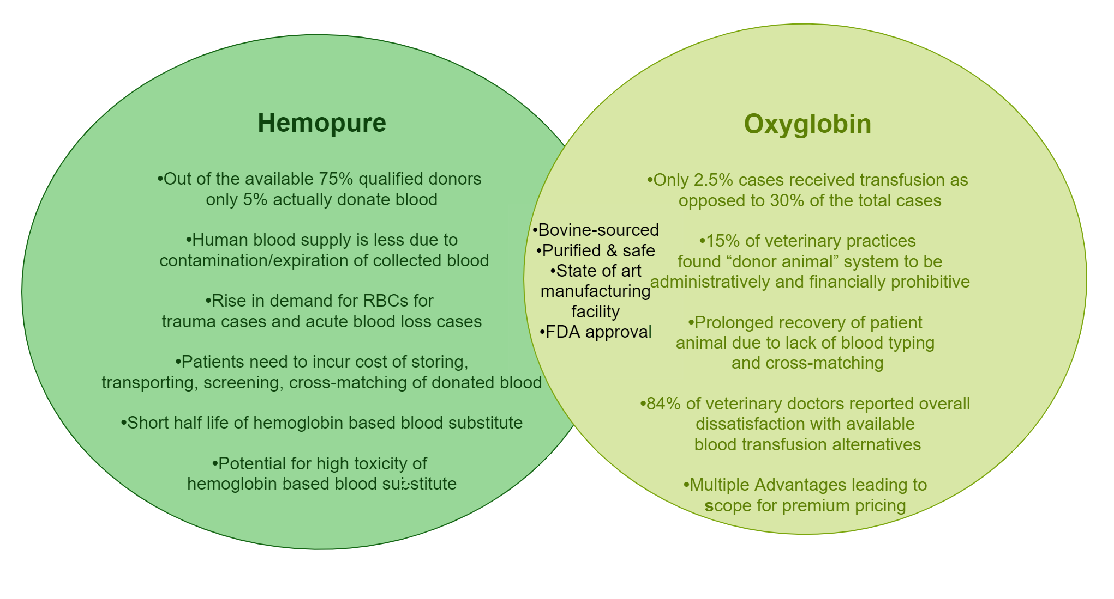

Slide 9
Reasons for exorbitant price | Hemopure
As there are already 2 competitors namely Baxter International and Northfield Laboratories.
Based on anticipatory price of ‘HemAssist’ from Baxter to be around $600 – $800 per unit.
Due to different production process as compared to others.
Lower output due to removal of hemoglobin clusters.
Lack of good systematic testing for acceptability and information regarding price sensitivity of medical personnel, patients or insurance providers.

Slide 10
The impact of Oxyglobin 's pricing on Hemopure
Oxyglobin and Hemopure in a sequence is posing a threat of product cannibalization
Hemopure is considered as a high-margin product (600$-800$), but the launch of Oxyglobin will reduce its worth and the consumers may perceive it as a low-price product.
They are planning to launch Oxyglobin at 80$ - 100$, but vets uses ‘Doubling Rule’, so they are thinking of pricing it at 160$-200$
The survey conducted among vets and pet owner shows, that they are willing to recommend the product and willing to buy the product with price range between 100$-150$ with 90% of their vote respectively

Slide 11
Challenges of how to go to market
Wait for Hemopure (FDA APPROVAL, currently in phase 3) will take upto 2 years and Biopure Corporation is Optimistic about the approval but is not guaranteed
Single Manufacturing unit
Risk of losing first mover advantage and market attractiveness for Oxyglobin, since Baxter’s HemAssist is also in development and might beat them to product launch
Lack of awareness on competition or substitutes in the market

Slide 12
Challenges of how to go to market
Handling Market expectations due to identical products
(price gap between Hemopure and Oxyglobin)
Distribution not stable for veterinary medicines
Poor revenue stream and inability to generate profits at regular intervals
Hemopure shortcomings
Presence of strong competitors in human blood substitute market

Slide 13
Conclusion
Launch of Oxyglobin by Biopure Corp immediately
Pricing of Oxyglobin at $200
Generated revenues expand the production capacity
In case of Hemopure rejection, Oxyglobin will dominate the market

